Slide 1



Django - React Chrome Extension
YT- Transcript Summarizer in Different Languages
Made by : Jai Anand
2016792
Under the Guidance of
Ms Meenakshi Maindola
Assistant Professor, GEU Dehradun

Slide 2

Tools Used
1.) Django and Django REST Framework
The backend is built on top of python's web framework Django.
2.) React JS
The client side is built on top of Javascript's famous Library React
3.) Data Manipulation tools and modules
Tools like : Scipy, NLTK, YoutubeTranscriptAPI
4.) DeepLearning Tools for Models
Tools like : Pytorch, Tensorflow, Deep Multi Lingual Model, Pipelines(Bert),

Slide 3

What is Summarization?
Summarizing is condensing a piece of information, such as an article or a book, into a shorter form while retaining the key points and main ideas. It aims to provide a concise overview of the original content.
Extractive Summarization: It involves selecting and extracting the most important sentences or phrases from the original text to create a summary. The summary consists of pieces of the original content and does not include any new information.
Abstractive Summarization: This type involves generating a summary that may contain rephrased or paraphrased information from the original text. It goes beyond simple extraction and uses natural language processing techniques to generate a summary that captures the essence of the content while using new phrasing.

Slide 4

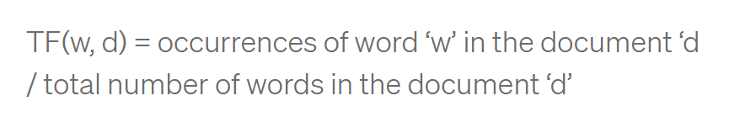
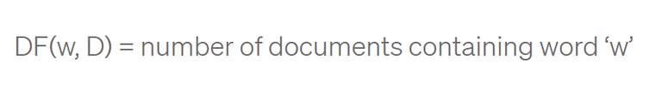
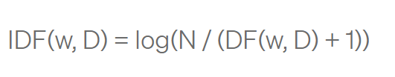
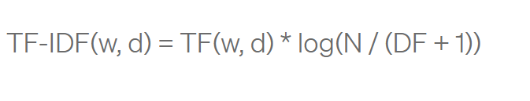
Extractive Summarization TF-IDF
Extractive summarization using TF-IDF (Term Frequency-Inverse Document Frequency) involves the following steps:
Calculating the importance score of each word based on its frequency in the document and rarity in the entire corpus.
Identifying the most important sentences based on the cumulative importance scores of the words they contain.
Selecting the top-ranking sentences to form the extractive summary.

Slide 5
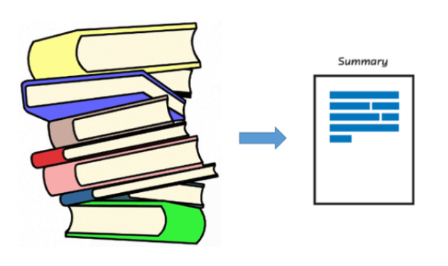
Abstractive Summariztion
Abstractive summarization with BERT (Bidirectional Encoder Representations from Transformers) involves the following steps:
Fine-tuning a pre-trained BERT model on a summarization task.
Encoding the input text using BERT to capture contextual information.
Decoding the encoded representation to generate a summary by predicting the most relevant words and phrases.

Slide 6
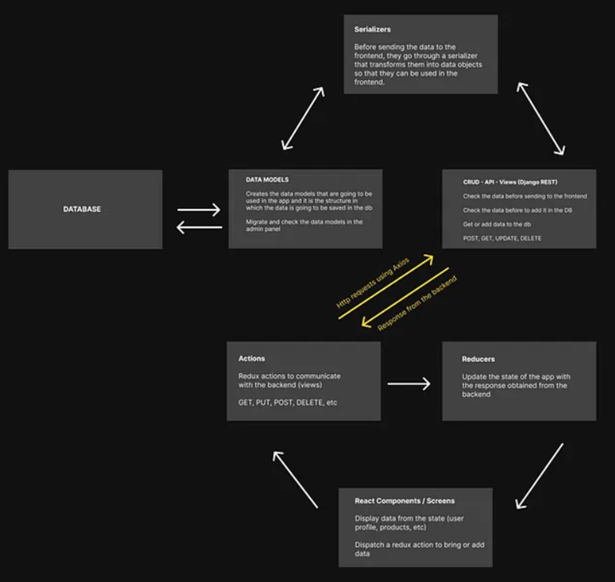

Flow Chart

Slide 7

API Endpoints
/api/getLanguages/ (POST)
Sends the language of different transcripts
/api/getSummary/ (POST)
Sends summary to the client (abstractive)
/api/tfidfSummary/ (POST)
sends extractive summarization summary
/api/getData/ (GET)
/api/getData/?url=
logs in all/one the summary of url along with langauge for abstractive summarization

Slide 8
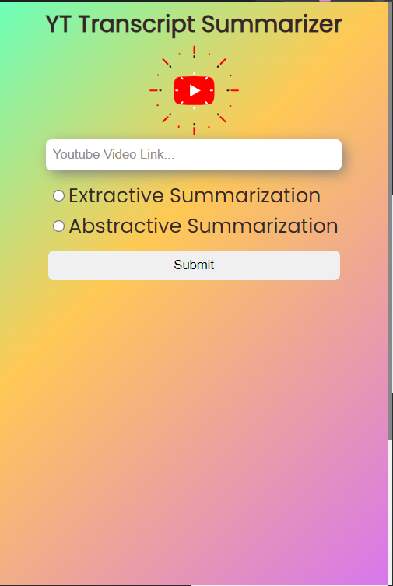
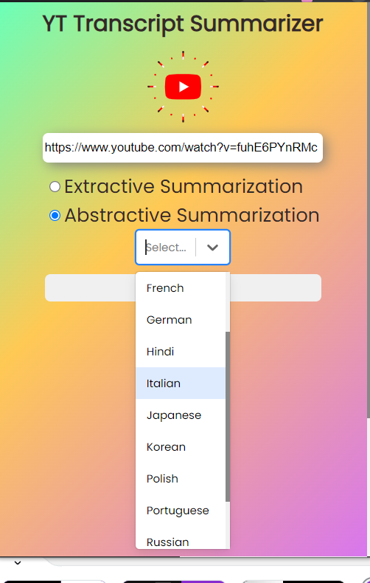
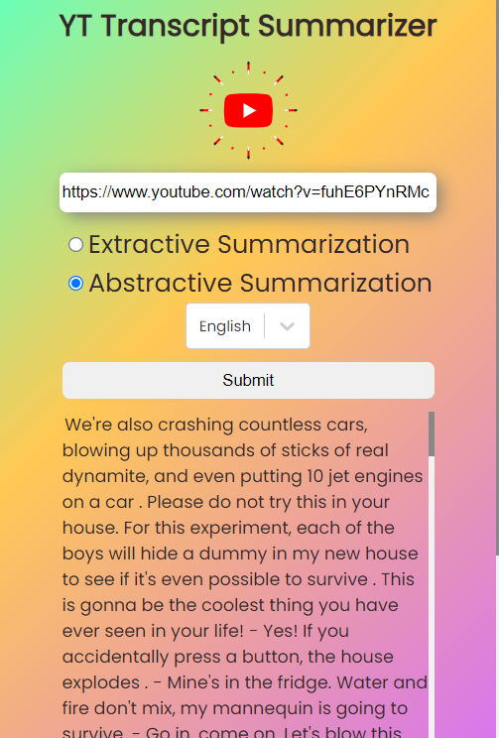
Results and Discussion
UI Screens for the application

Slide 9


Limitations and Challenges
1.) Summarization Quality: Generating high-quality summaries that capture the essence of the original content can be challenging. Extractive summarization may result in disjointed sentences, while abstractive summarization may produce summaries that deviate from the original text.
2.) Scalability: Handling large volumes of YouTube transcripts and processing them in real-time can be resource-intensive. Ensuring that the summarization process is scalable and efficient is crucial.
3.) Language Understanding: YouTube transcripts can contain informal language, slang, or domain-specific terminology. Ensuring that the summarization algorithm understands and accurately captures the meaning of the text can be a challenge.
The Application for now summarizes in 8 different languages, in the model

Slide 10

Future Scope
1.) Fine-tuning Models: Fine-tune the pre-trained Transformer models on domain-specific data to improve the quality of the summaries. Involves collecting and annotating a dataset of YouTube transcripts specific to a particular domain and fine-tuning the model.
2.) User Feedback and Evaluation: Gather user feedback on the generated summaries to evaluate their quality and usefulness. Use this feedback to iteratively improve the summarization system and make it more aligned with user expectations.
3.) Real-time Summarization: Develop a real-time summarization feature that can generate summaries as the video is being played.
4.) Enhanced support with multiple languages

Slide 11





THANK YOU

